Slide 1
DEPI Graduation Project
Project 3 : Advanced Wireless Network Setup & Security
Applied on Small Hotel Wireless LAN
click to navigate to project repository

Slide 2
Team Members
Saif-aleslam Mohammed Mohsen
Marwan Hamdy Mohy Eldin
Mohammed Raafat Al-Hennawy
Jana Mohammed
Yousef Ayman

Slide 3
Project Overview
We aim to apply Project No. 3 on a wireless local area network for a small hotel, where the network consists of user devices, network devices and some protocols used in Cisco devices that aim to enhance performance and security, as we aspire to simulate a network that does the following :
Isolate hotel guests from the hotel system by providing a dedicated wireless network.
Establishing a network of staff in the hotel that provides connectivity for both guest service and reception.
The network of managers where they can manage the hotel .
The Isolated network for security and surveillance cameras .
Finally, the technical support network and IT officials , which in turn can access all hotel networks, from guests to management.

Slide 4
System Features
System Users
  (Guests , IT & Technical Support , Management , Staff)
  The maximum Number of Guests at the same time is 100 Guest
  At most 5 devices with managerial Access
  Hotel Staff Number may Grow so the network of staff should be allow Devices more than the number of the actual Staff Number which now is 30 .
  Just 4 or more PCs With IT Accessibility

Slide 5
CON..
System Expected Devices
  Because the system is responsible for a small hotel, the number of devices responsible for controlling and configuring this system will not be in large numbers so as not to be a waste of resources ;
  SO we expect that the system will consist of the following :
  A maximum of two Cisco routers type 2911
  Max 2 Cisco Switch Multi-layer Device 3560-24BS
  Maximum number of 3 Cisco Switch devices type 2960 IOS15
  Maximum 6 Cisco lightweight LAP-APT access points
  Max 1 x WLC-3504 wireless controller
  Maximum of 2 Cisco AP-APT devices
Considering that each room in the hotel has a computer connected to the network, considering the presence of IP phone devices to communicate, and considering the presence of surveillance cameras with various other end-users' devices, whose exact number is difficult to determine because it is a destination for Scalability.

Slide 6
Network Design
The hotel consists of two buildings for administration and a guest building ;
where The administration building consists of two floors , the ground floor consists of the administration department and the security and surveillance department , while the upper floor is all for the central Devices responsible for the network Control and Configuration , and it belongs to IT and technical support officials only ;
as for the other building, it consists of four floors, the ground floor for reception and guest service, and the rest of the upper floors are for guests .
Guest Building Access The Network Wirelessly Except Few Things .

Slide 7

CON..

Slide 8
VLANS & Scopes
Network For | VLAN ID | SSID (if wireless) | Access Scope
Hotel Guests | 10 192.168.10.0 /24 | Hotel_Guests | Internet only (isolated from LAN)
Hotel Staff (Reception) | 20 192.168.20.0/26 | Hotel_Staff | Guest services systems only
Hotel Managers | 30 30.0.0.0/28 | Hotel_Management | Access to staff + management tools
Security & Surveillance Cameras | 40 10.0.0.0/28 | (Sec-SurvCams) | Isolated network
Voice | 60 172.16.1.0/26
IT & Technical Support | 50 50.0.0.0/28 | Hotel_IT | Acess to all networks
Network For | VLAN ID | SSID (if wireless) | Access Scope
New -GST | 120 120.0.0.0/24 | NW_GST | Internet & Staff
RST | 125 125.0.0..0/26 | RST-STAFF | Internet
HR | 80 80.0.0.1/26 | HR | Some Managerial Access

Slide 9
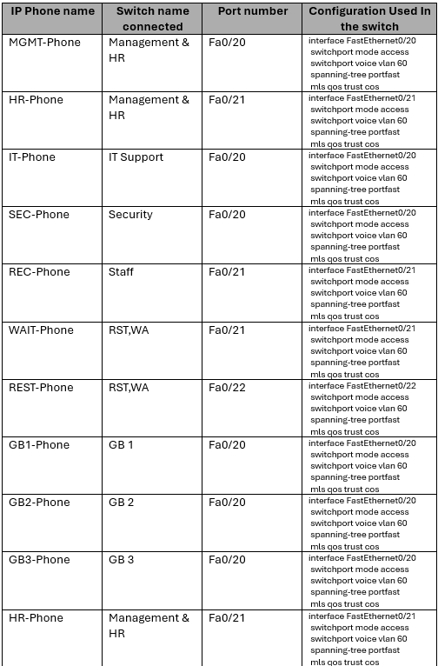
IP Phone
Data and voice traffic are accommodated by the network through VLAN segmentation with each user group associated with a data VLAN, which is a means of isolation and security. IP phones are connected accross a single cable and a DHCP server provides all IP addresses.

Slide 10
Wireless Configuration Overview
1.Wireless Configuration Implementation
Configured two Wireless LAN Controllers:
  WLC1 (50.0.0.6) for Guest Networks
  WLC2 (50.0.0.8) for Internal Hotel Departments
Created multiple Wireless LANs (WLANs) with appropriate SSIDs and security settings
Created a wireless interface for each Vlan
Defined AP Groups to control which Access Points broadcast which WLANs
Configured Lightweight Access Points (LAPs) to join the correct WLC and associate with their assigned AP groups

Slide 11
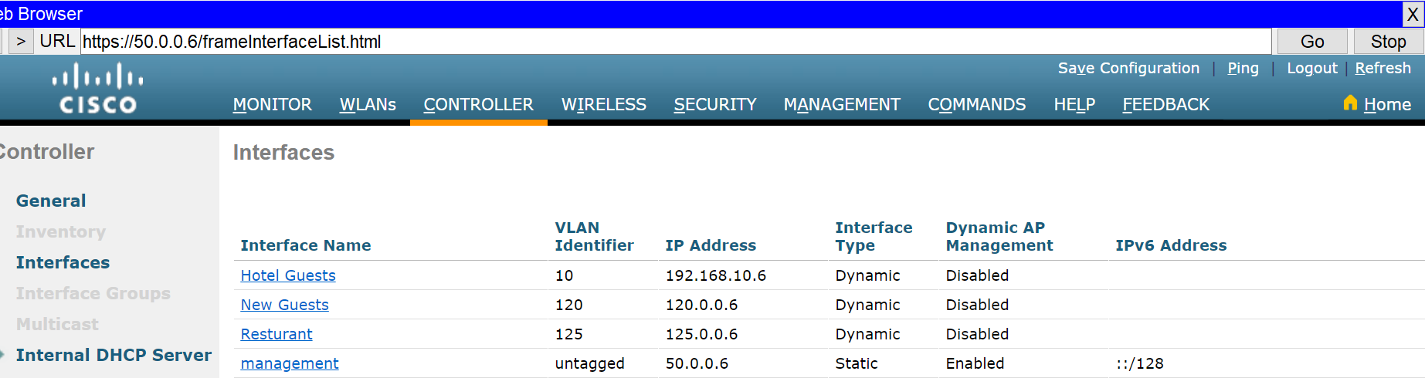
Guest WLC (50.0.0.6) Configuration
1-Interfaces

Slide 12
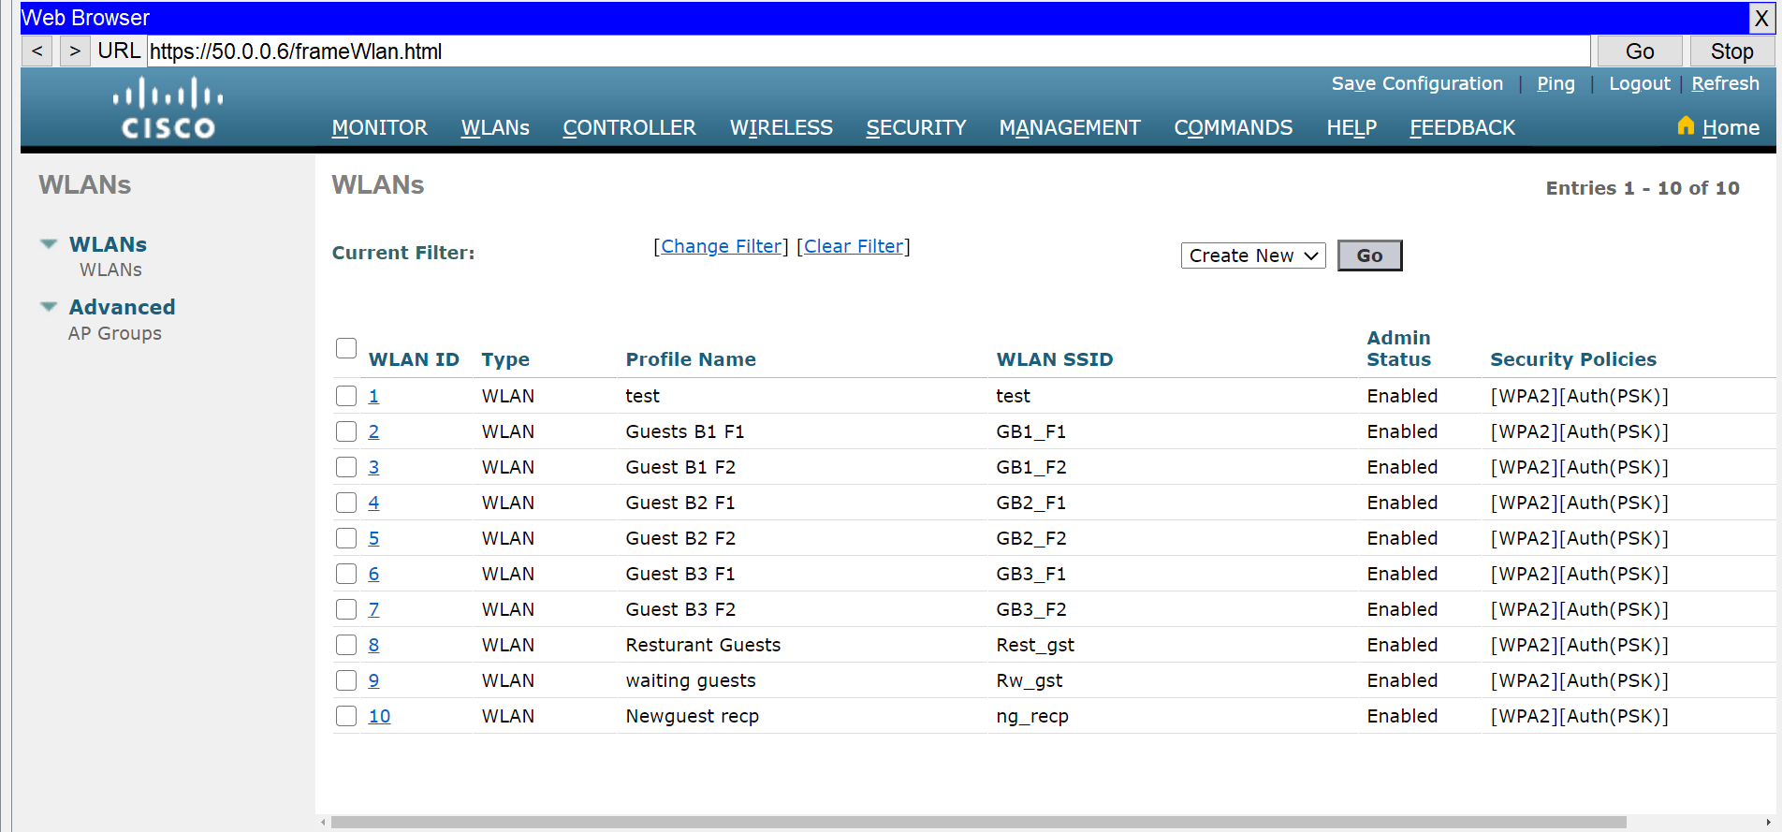
2- networks

Slide 13
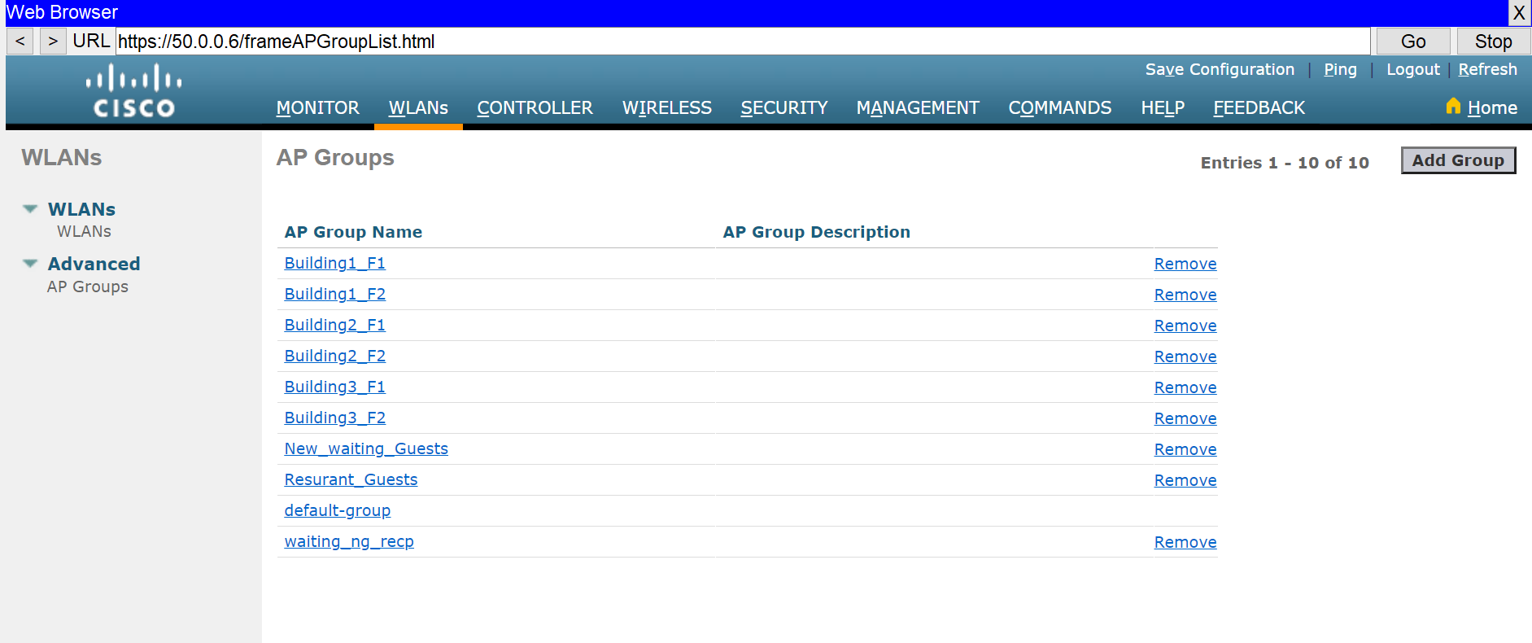
3-AP Groups

Slide 14
WLC2 (50.0.0.8) configuration
Manages wireless networks for internal hotel departments,including:
  Security
  HR Department
  Staff and Employees
  Management
Offers secure access to internal systems and services.
VLANs are configured per department for isolation and control.

Slide 15
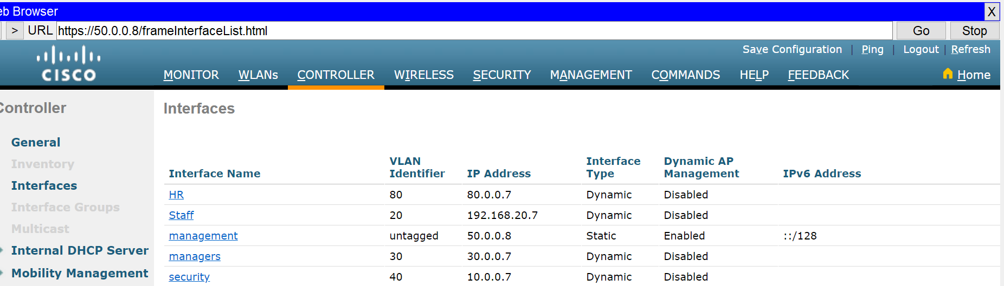
1-Interfaces

Slide 16
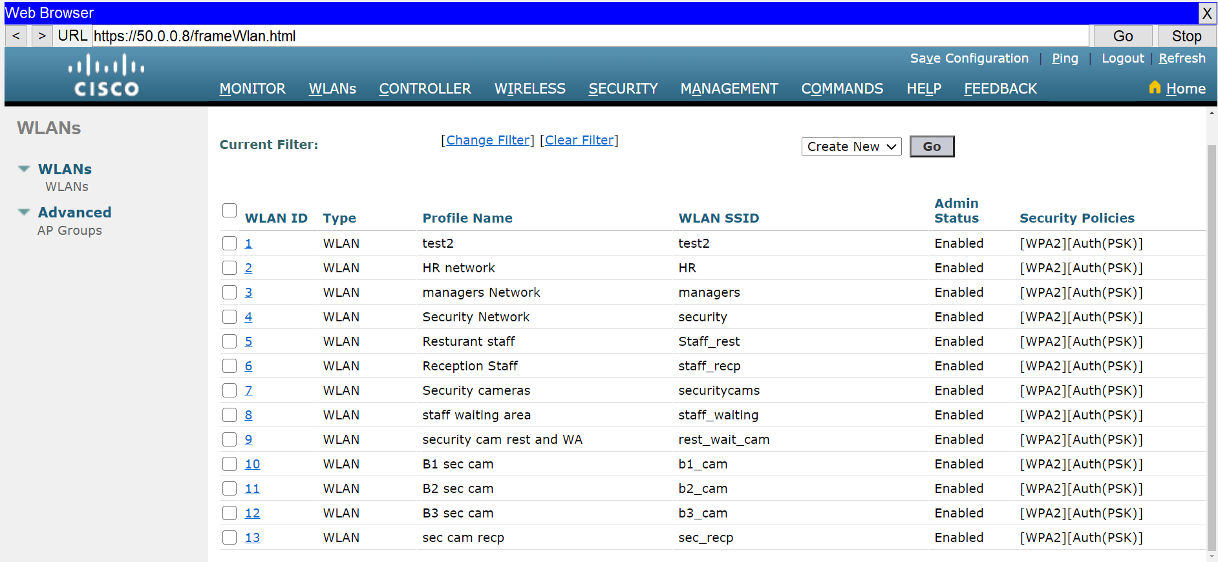
2-Networks

Slide 17
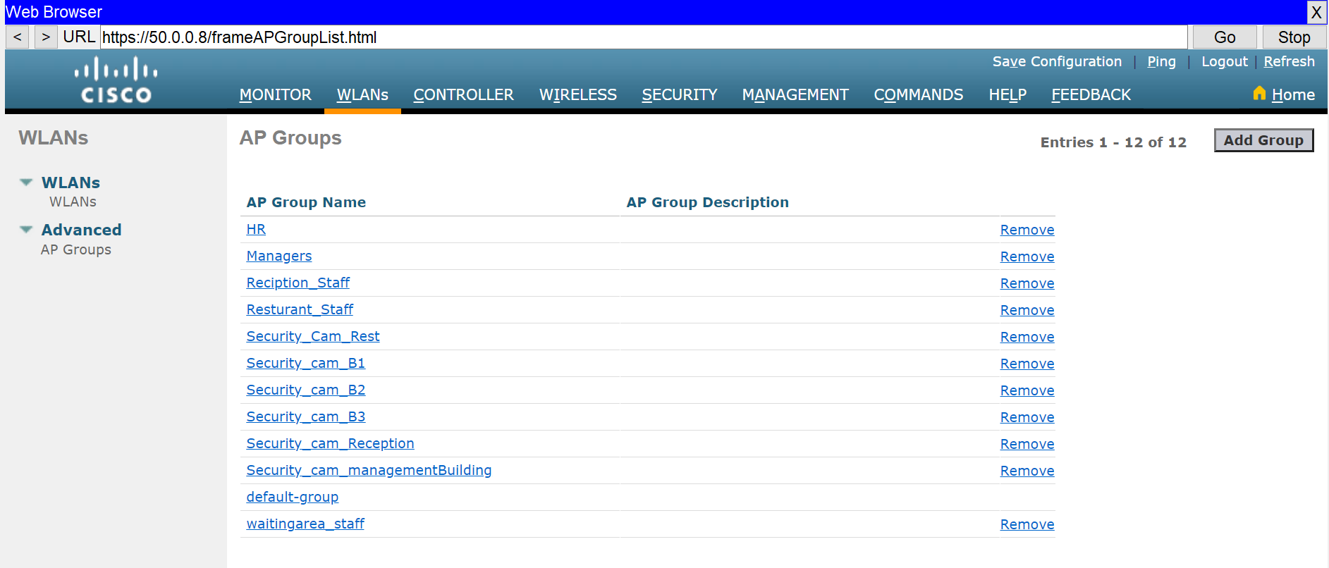
3-Ap Groups

Slide 18
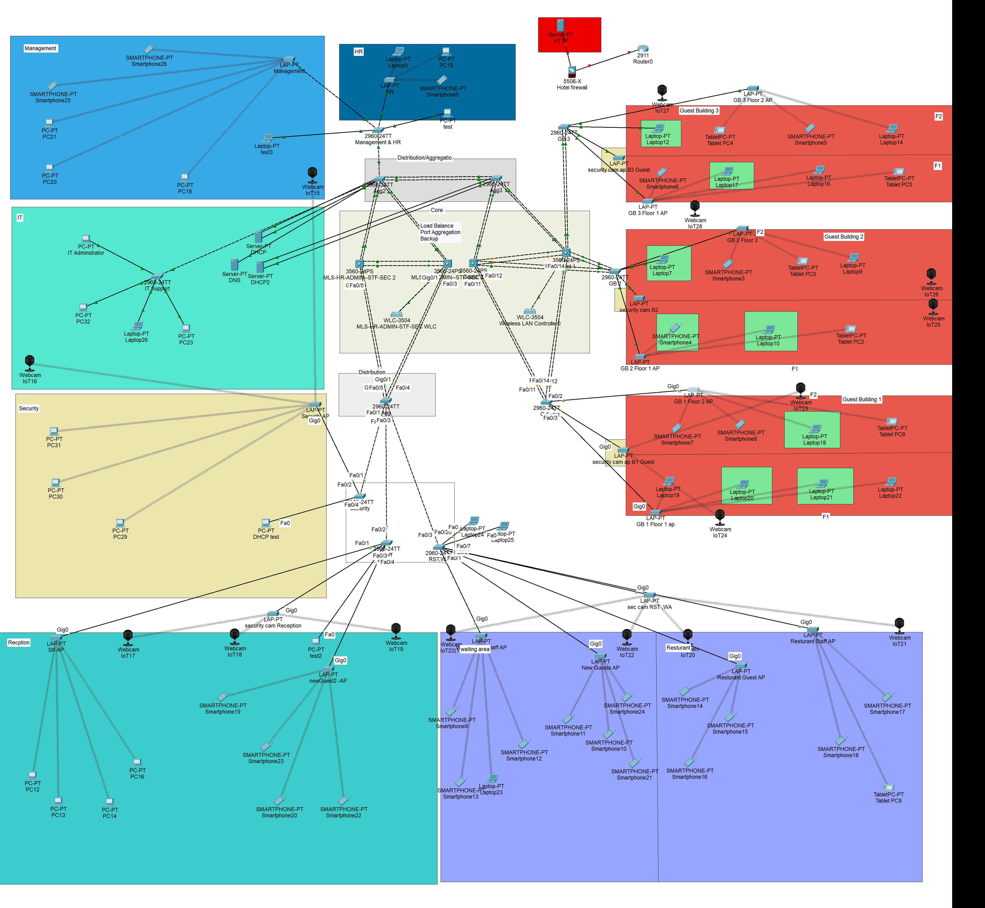
Network after configuration of wireless

Slide 19
Management & HR Switch
Hostname: manage
Domain: manage.com
Line Console Password: managehr
Enable Password: cisco@123
Username: managesw
Secret: manage1
SSH Access: line vty 0 2 (3 devices)
Interfaces:
- Shutdown: fa0/3 – 7 , fa0/9 - 22

Slide 20
GB_3 Switch
Hostname: GB_3
Domain: GB_3.com
Line Console Password: cisco3
Enable Password: cisco@123
Username: GB3
Secret: GB3sw
SSH Access: line vty 0 2 (3 devices)
Interfaces:
- Shutdown : fa0/8 - 9, fa0/11 - 20, fa0/22 – 24

Slide 21
Aggregation2 Switch
Hostname: Aggregation2
Domain: Aggregation2.com
Line Console Password: agg2
Enable Password: cisco@123
Username: Agg2
Secret: Agg2sw
SSH Access: line vty 0 2 (3 devices)
Interfaces:
- Shutdown : fa0/5 – 9 , fa0/12 - 14, fa0/16 - 19

Slide 22
Aggregation3 Switch
Hostname: Aggregation3
Domain: Aggregation3.com
Line Console Password: agg3
Enable Password: cisco@123
Username: Agg3
Secret: Agg3sw
SSH Access: line vty 0 2
Interfaces:
- Shutdown : fa0/3, fa0/6 - 9, fa0/11 - 14, fa0/16 - 20, fa0/23

Slide 23
IT Support Switch
Hostname: IT
IP Domain Name: IT.com
Line Console Password: itsupport
Enable Password: cisco@123
Username: it
Secret: itsw
SSH Access: line vty 0 2 (3 devices)
Interfaces:
- Shutdown : fa0/7 – 24 , g0/2

Slide 24
SSH
VLAN 50 Configuration:
- IP Address: 50.0.0.3
- Subnet Mask: 255.255.255.240 (/28)
Console cables connected to 2 devices:
PC23 connected to MLS-HR-ADMIN--STF-SEC 2
IT Adminstrator connected to MLS-HR-ADMIN--STF-SEC 1

Slide 25
MLS-HR-ADMIN--STF-SEC 2
Hostname: Hotel_Core2
IP Domain Name: Hotel_Core2.com
Line Console Password: Core2
Enable Password: cisco@123
username: HotelCore2
secret: core2
SSH Access: line vty 0 2 (3 devices)
Interfaces:
- Shutdown : fa0/4 , fa0/6 – 19 , fa0/22 – 24

Slide 26
MLS-HR-ADMIN--STF-SEC 1
Hostname: Hotel_Core1
IP Domain Name: Hotel_Core1.com
Line Console Password: Core1
Enable Password: cisco@123
username: HotelCore1
secret: core1
SSH Access: line vty 0 2 (3 devices)
Interfaces:
- Shutdown : fa0/6 – 9 , fa0/12 – 24

Slide 27
Guest 2
Hostname: Guest_Core2
IP Domain Name: Guest_Core2.com
Line Console Password: Guest2
Enable Password: cisco@123
username: GuestCore2
secret: guest2
SSH Access: line vty 0 2 (3 devices)
Interfaces:
- Shutdown : fa0/7– 9 , fa0/13 – 20 , fa0/23 , g0/2

Slide 28
Guest 1
Hostname: Guest_Core1
IP Domain Name: Guest_Core1.com
Line Console Password: Guest1
Enable Password: cisco@123
username: GuestCore1
secret: guest1
SSH Access: line vty 0 2 (3 devices)
Interfaces:
- Shutdown : fa0/8– 9 , fa0/11 – 12 , fa0/15 , fa0/21 – 22

Slide 29
Agg 1 Switch
Hostname: Aggregation_1
IP Domain Name: Aggregation_1.com
Line Console Password: agg1
Enable Password: cisco@123
username: Agg1
secret: Agg1sw
SSH Access: line vty 0 2 (3 devices)
Interfaces:
- Shutdown : fa0/8– 24

Slide 30
GB_1 Switch
Hostname: GB_1
Domain: GB_1.com
Line Console Password: cisco1
Enable Password: cisco@123
Username: GB1
Secret: GB1sw
SSH Access: line vty 0 2 (3 devices)
Interfaces:
- Shutdown : fa0/6 - 10, fa0/15 - 20, fa0/22 – 24 , g0/1-2

Slide 31
Security Switch
Hostname: Security
Domain: Security.com
Line Console Password: Secsw
Enable Password: cisco@123
Username: sec
Secret: secsw
SSH Access: line vty 0 2 (3 devices)
Interfaces:
- Shutdown : fa0/6 - 24, g0/1-2

Slide 32
Staff Switch
Hostname: Staff
Domain: Staff.com
Line Console Password: staffsw
Enable Password: cisco@123
Username: staff
Secret: Staffsw
SSH Access: line vty 0 2 (3 devices)
Interfaces:
- Shutdown : fa0/7 – 19 , fa0/21 - 24 , g0/1-2

Slide 33
RST,WA Switch
Hostname: Restaurant
Domain: Restaurant.com
Line Console Password: rst
Enable Password: cisco@123
Username: rest
Secret: restsw
SSH Access: line vty 0 2 (3 devices)
Interfaces:
- Shutdown : fa0/10 – 19 , fa0/21 - 24 , g0/1-2

Slide 34
GB_2 Switch
Hostname: GB_2
Domain: GB_2.com
Line Console Password: cisco2
Enable Password: cisco@123
Username: GB2
Secret: GB2sw
SSH Access: line vty 0 2 (3 devices)
Interfaces:
- Shutdown : fa0/6 - 9, fa0/11 - 14, fa0/19 – 21 , fa0/23 , g0/1-2

Slide 35
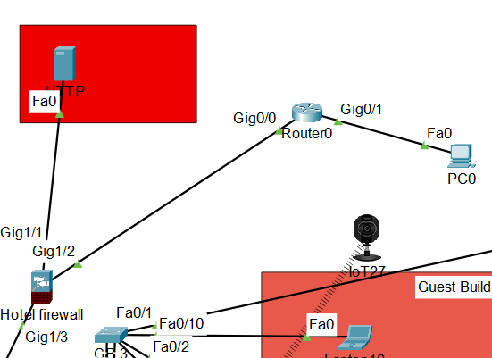
Firewall
Interface IP 192.168.1.1/24
DMZ Zone
Firewall Interface IP 100.100.100.2/30
HTTP/HTTPS Server have inside IP 192.168.1.10/24 and outside IP 100.100.100.10
Outside Zone
Interface IP 90.90.90.1/24
Inside Zone

